Slide 1
Operating System
Lecture #1
Introduction to OS

Slide 2
Objectives
To understand the organization of computer system.
Learn about bootstrap program.
To understand concept of Instruction cycle and registers
Get familiar with interrupts and its types
Maskable and Non maskable interrupts.
Examples of Maskable and Non maskable Interrupts.

Slide 3
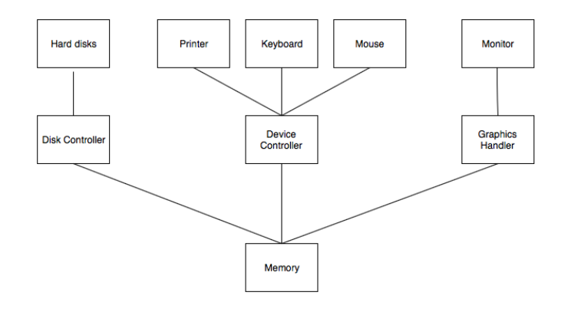
Computer System Organization

Slide 4
Computer System Organization
The I/O devices and the CPU both execute concurrently. Some of the processes are scheduled for the CPU and at the same time, some are undergoing input/output operations.
There are multiple device controllers, each in charge of a particular device such as keyboard, mouse, printer etc.
There is buffer available for each of the devices. The input and output data can be stored in these buffers.
The data is moved from memory to the respective device buffers by the CPU for I/O operations and then this data is moved back from the buffers to memory.
The device controllers use an interrupt to inform the CPU that I/O operation is completed.

Slide 5
Bootstrap Program
A bootstrap program is the first code that is executed when the computer system is started.
The entire operating system depends on the bootstrap program to work correctly as it loads the operating system.
The bootstrap program is a part of ROM which is the non-volatile memory.
The operating system is loaded into the RAM by the bootstrap program after the start of the computer system.
Then the operating system starts the device drivers.
The bootstrapping process does not require any outside input to start.
Any software can be loaded as required by the operating system rather than loading all the software automatically

Slide 6
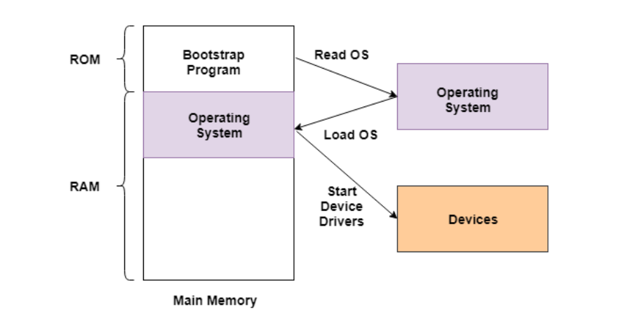
Bootstrapping process

Slide 7
Bootstrapping process
The bootstrapping process is performed as a chain i.e. at each stage,
it is the responsibility of the simpler and smaller program to load and execute the much more complicated and larger program.
This means that the computer system improves in increments by itself.
The booting procedure starts with the hardware procedures and then continues onto the software procedures that are stored in the main memory.
The bootstrapping process involves self-tests, loading BIOS, configuration settings, hypervisor, operating system etc.

Slide 8
Benefits of Bootstrapping
Without bootstrapping, the computer user would have to download all the software components, including the ones not frequently required.
With bootstrapping, only those software components need to be downloaded that are legitimately required and all extraneous components are not required.
This process frees up a lot of space in the memory and consequently saves a lot of time.

Slide 9
Registers/Buffers
User-visible registers
Control and status registers

Slide 10
User-visible registers
Enable programmer to minimize main- memory references by optimizing register use.
May be referenced by machine language
Available to all programs - application programs and system programs
Types of registers –Data and Address
Address : Index, Segment pointer, and Stack pointer

Slide 11
User-visible registers
Address Registers
Index involves adding an index to a base value to get an address
Segment pointer when memory is divided into segments, memory is referenced by a segment and an offset
Stack pointer points to top of stack

Slide 12
Control and status registers
Used by processor to control operating of the processor
Used by operating-system routines to control the execution of programs
Program Counter (PC) –Contains the address of an instruction to be fetched
Instruction Register (IR) –Contains the instruction most recently fetched
Program Status Word (PSW) –condition codes , Interrupt enable/disable, Supervisor/user mode

Slide 13
Control and status registers
Condition Codes or Flags –Bits set by the processor hardware as a result of operations
Can be accessed by a program but not altered
Examples positive result, negative result. Zero, Overflow

Slide 14
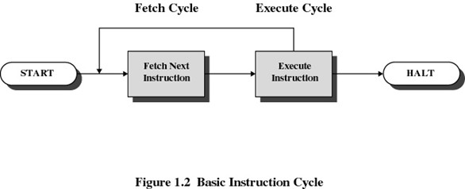
Instruction Cycle

Slide 15
Instruction Cycle
Instruction Fetch and Execute The processor fetches the instruction from memory
Program counter (PC) holds address of the instruction to be fetched next
Program counter is incremented after each fetch

Slide 16
Interrupts
An interruption of the normal sequence of execution
Improves processing efficiency
Allows the processor to execute other instructions while an I/O operation is in progress
A suspension of a process caused by an event external to that process and performed in such a way that the process can be resumed

Slide 17
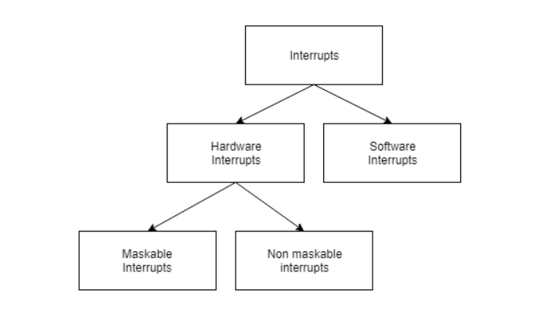
Interrupts

Slide 18
Interrupts
Hardware and software interrupts are two types of interrupts.
Hardware interrupts are triggered by hardware peripherals while
software interrupts are triggered by software function calls.
Hardware interrupts are of further two types. Maskable interrupts can be ignored or disabled by the CPU while this is not possible for non maskable interrupts.

Slide 19
Examples of Interrupts
Program –arithmetic overflow –division by zero –execute illegal instruction –reference outside user’s memory space
Timer
I/O Hardware failure

Slide 20
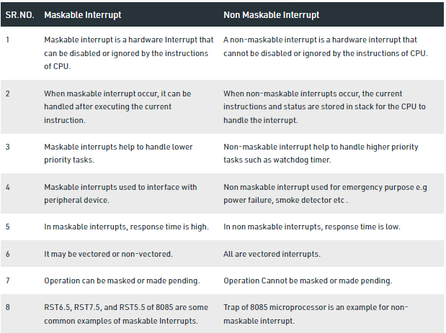

Slide 21
Interrupt Handler
A program that
determines nature of the interrupt and
performs whatever actions are needed Control is transferred to this program Generally part of the operating system.
Processor checks for interrupts
If no interrupts, fetch the next instruction for the current program
If an interrupt is pending, suspend execution of the current program, and execute the interrupt handler

Slide 22
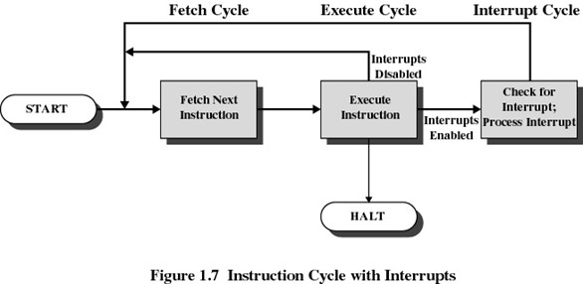
Interrupt Cycle

Slide 23
Any Query??

